Slide 1




Asthma attacks in the Strasbourg metropolitan area (SMA): spatial analysis in relation to air pollution & neighbourhood deprivation (PAISARC+ study*)
1
* Sponsored by ANSES
Dr. Soutrik Banerjee, EPAR, Paris
Pr. Clive E. Sabel, ECEHH, Truro
Dr. Wahida Kihal, EHESP, Rennes
Dr. Christiane Weber, LIVE, Strasbourg
Dr. Isabella Annesi-Maesano, EPAR, Paris
Pr. Denis Bard, EHESP, Rennes
EPAR (Epidemiology of Allergic and Respiratory Diseases) Department,
Inserm UMR-S 707 – UPMC-Sorbonne, Paris

Slide 2
Background (1)
2
Socio-economic deprivation is associated with traffic-related air pollution¹
Deprivation is also shown to be associated with asthma attacks²
Urban air pollution plays a putative role in increasing the risk of asthma³
However, the modifying role of socio-economic deprivation in the association between air pollution and asthma is less clear
¹ Næss, Ø et al. 2007, Havard, S et al. 2009; ² Laurent, O et al. 2008, 2009; ³ Pénard-Morand, C et al. 2010

Slide 3
Background (2)
3
In the literature, two theories are put forward¹:
Differential exposure – studies have shown that the most deprived are often the most exposed to air pollution
In this case, deprivation would ‘absorb’ a part of the variability explained by air pollution (attenuation effect)
Differential susceptibility / vulnerability – this signifies that the impact of air pollution is modified by deprivation (often the more deprived are the most vulnerable to the effects of pollution)
In this case, an interaction would be observed between air pollution and socio-economic deprivation
¹ Laurent, O et al. 2007, Deguen, S et al. 2010

Slide 4
Schematically
4
Air pollution
Asthma attacks
Confounder? Effect modifier?
Deprivation

Slide 5
Objectives¹
5
Study the role played by neighbourhood deprivation in the putative link with asthma due to air pollution in a purely spatial context
Determine primary clusters (‘hotspots’) and how they shift after adjusting by covariates
¹ Bard, D et al. 2007

Slide 6
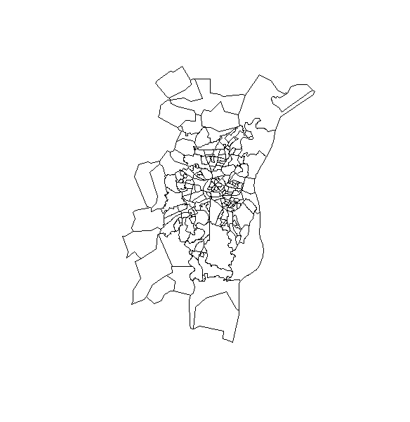
Study: description
6
Setting: small area spatial analysis
Design: ecological
Period: 2000-08 (= 9 years)
Population: residents of SMA
Zones: AZToolTM by the Southampton university (UK) used to create new ‘zones’ by minimising intra-zone (W) variability and maximising inter-zone (B) variability; also making the new ‘zones’ resemble as closely as possible to an ‘IRIS’ zone, equivalent to a census area unit (192 new ‘zones’ were included in this analysis*)
Notes:
* 19 blocks were excluded due to sparse populations (0.8% of the SMA population).
1,608 original zones of size 250 m x 250 m were coalesced to 192 new synthetic ‘zones’ with AZTool.
Resemble in terms of the population size.

Slide 7
Outcome: description
7
Asthma attack calls = ‘cases’ (ICD-9 code: 493.xx) reported by ‘SAMU / SOS médecins’
Caveat: for younger population, gender was not recorded
Categorised into following age-groups: 0-9, 10-19, 20-39, 40-64, 65+ years
‘Zone’ of intervention recorded
Caveat: 2% of the attacks could not be geocoded → excluded
Date of the asthma attack recorded
SIRs were computed for each zone by indirect internal standardisation by the age-groups

Slide 8
Exposure: description (1)
8
Five air pollutants were selected for this study:
Traffic-related: NO₂, PM₁₀, CO, Benzene
From industrial emissions: SO₂
Data were collected by ASPA-Alsace
ADMS (proximity) model was employed to calculate the hourly zonal concentrations using emission inventories (i.e., road traffic, residential & industrial emissions), meteorological data, background pollution concentrations
Notes:
ADMS = Atmospheric Dispersion Modelling System.
O₃ will not be presented in this study.

Slide 9
Exposure: description (2)
9
Yearly means were computed based on 8-hour maximum value recorded
The yearly means were averaged over 9 years
It was noted that the traffic-related air pollutants were very correlated ⬄ ‘PC1’ explained 97% of the total variability
Mean of the max ‘PC1’ and SO₂ concentrations were categorised into 5 quintiles (0-4)
In summary: for each ‘pollutant’ in a zone: conc. /hr. → 8-hour max/24 hrs. → mean/yr. → avgd. over 9 years → 5 quintiles → attributed to each ‘zone’

Slide 10
Neighbourhood deprivation index (NDI): description (equivalently, socio-economic status (SES))
10
Derivation carried out in two steps¹:
Multiple factor analysis (MFA)
Agglomerative hierarchical classification (AHC)
Variables used comprised of 4 categories:
Socio-economic environment
Access to public resources
Indoor & outdoor physical environment
Psychosocial environment
Categorised into 5 classes (‘A’ through ‘E’, equivalently, ‘1’ through ‘5’) → attributed to each zone
¹ Sabel, C et al., Kihal, W et al. (manuscript submitted)
Notes:
They are not quintiles, but classified by HAC.

Slide 11
Software
11
SPAD® 7.0
Create new neighbourhood deprivation index
AZTool® (Southampton University, UK)
Create synthetic neighbourhood areas ‘zone’ for the study
R 14.x (CRAN)
Disease mapping
Smoothing
Autocorrelation
Disease clustering
Ordinary variogram kriging: exposure, outcome & SES
SAS® 9.2 / 9.3 (SAS institute, Cary, NC, USA)
Datasets derivation
Descriptive analysis
Naive analysis
SaTScan 9.1 (Kulldorff)
Kulldorff’s scan statistic
WinBUGS (MRC, UK)
CAR models

Slide 12
Essential statistics
12
Pollutants | Mean* (µg/m³) | SD (µg/m³)
NO₂ | 65.7 | 9.3
PM₁₀ | 21.1 | 1.8
CO | 806.0 | 162.6
Benzene | 1.8 | 0.3
SO₂ | 9.0 | 1.6
SES category | N | %
‘A’ | 17 | 8.85
‘B’ | 61 | 31.77
‘C’ | 55 | 28.65
‘D’ | 21 | 10.94
‘E’ | 38 | 19.79
10,296 asthma attack cases were reported between 2000 and 2008 in 192 zones (or census blocks)
* Mean signifies here the mean of the 8-hour maximum value recorded during a 24-hour period

Slide 13
Results: NDI ⬄ pollution
13
Characteristics | Neighbourhood deprivation index
 | A |  | B |  | C |  | D |  | E
 | n | % | n | % | n | % | n | % | n | %
PC1 quintiles | 11 | 64.7 | 25 | 41.0 | 0 | 0.0 | 0 | 0.0 | 2 | 5.3
0
1 | 2 | 11.8 | 17 | 27.9 | 6 | 10.9 | 1 | 4.8 | 13 | 34.2
2 | 0 | 0.0 | 8 | 13.1 | 15 | 27.3 | 2 | 9.5 | 13 | 34.2
3 | 4 | 23.5 | 3 | 4.9 | 18 | 32.7 | 7 | 33.3 | 7 | 18.4
4 | 0 | 0.0 | 8 | 13.1 | 16 | 29.1 | 11 | 52.4 | 3 | 7.9
Total | 17 | 100 | 61 | 100 | 55 | 100 | 21 | 100 | 38 | 100
It seems that deprivation is likely associated with pollution, except for the most deprived category (‘E’)
Characteristics | Neighbourhood deprivation index
 | A |  | B |  | C |  | D |  | E
 | n | % | n | % | n | % | n | % | n | %
SO₂ quintiles | 11 | 64.7 | 26 | 42.6 | 1 | 1.8 | 0 | 0.0 | 0 | 0.0
0
1 | 4 | 23.5 | 13 | 21.3 | 8 | 14.5 | 2 | 9.5 | 12 | 31.6
2 | 1 | 5.9 | 11 | 18.0 | 8 | 14.5 | 2 | 9.5 | 16 | 42.1
3 | 1 | 5.9 | 6 | 9.8 | 21 | 38.2 | 4 | 19.0 | 7 | 18.4
4 | 0 | 0.0 | 5 | 8.2 | 17 | 30.9 | 13 | 61.9 | 3 | 7.9
Total | 17 | 100 | 61 | 100 | 55 | 100 | 21 | 100 | 38 | 100
Notes:
Counts & percentages distribution.

Slide 14
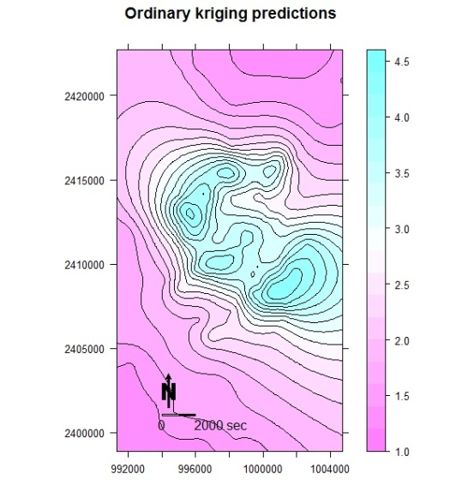
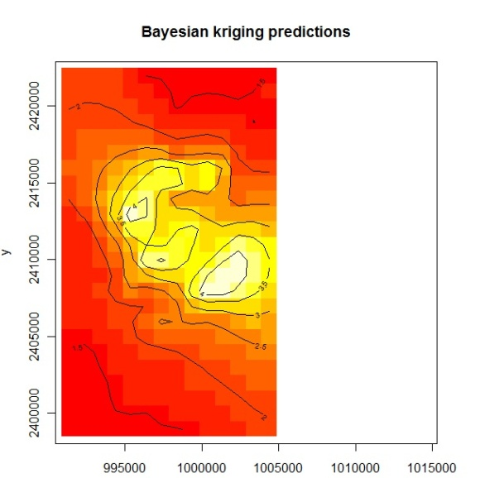
Spatial distribution of NDI: kriging
14
Ordinary kriging
Bayesian kriging
The more deprived areas are located in an oblique axis at the centre of SMA
Notes:
Errata: the scale legend ‘seconds’ should be replaced by ‘metres’.

Slide 15
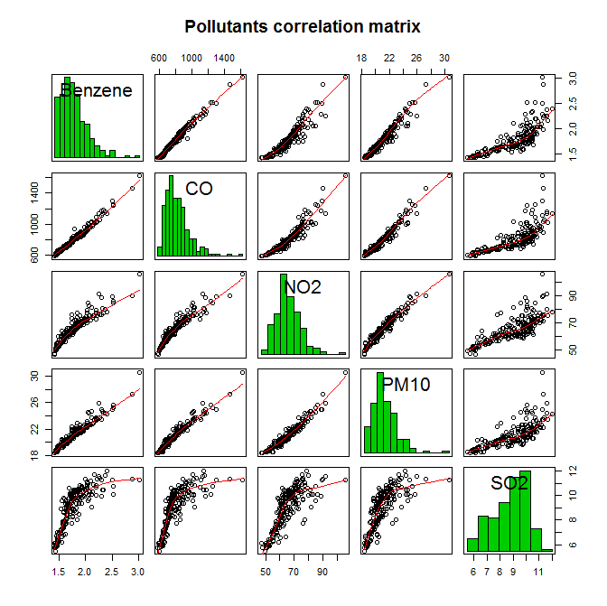
Results: correlation among the air pollutants
15
Benzene CO NO₂ PM₁₀ SO₂ | Benzene 1.0000000 0.9898158 0.9360946 0.9665565 0.7847812 | CO 0.9898158 1.0000000 0.9440025 0.9722655 0.7517549 | NO2 0.9360946 0.9440025 1.0000000 0.9697040 0.7759933 | PM10 0.9665565 0.9722655 0.9697040 1.0000000 0.7513969 | SO2 0.7847812 0.7517549 0.7759933 0.7513969 1.0000000

Slide 16
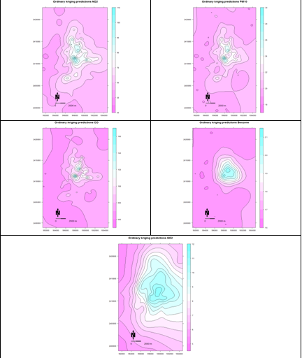
Spatial distribution of air pollutants
16
NO₂
PM₁₀
CO
Benzene
SO₂
Notes:
All traffic-related pollutants have higher concentrations at the central locations, decreasing centrifugally. SO₂ shows somewhat asymmetric distribution, with higher concentrations also at the central locations.

Slide 17
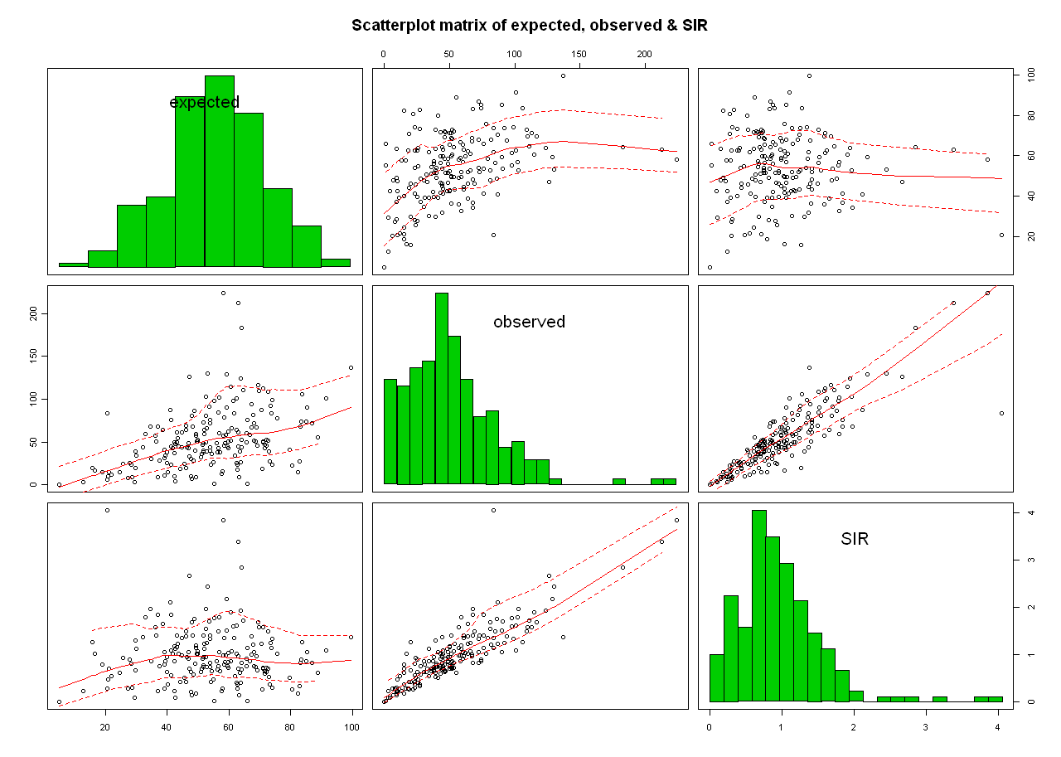
Distribution of the asthma SIR
17
SIRs show right skewing in both histogram and caterpillar plot
Notes:
SMR is standardised by age-groups.
Total variance (Poisson-gamma model) = 0.33 (The mean = 1).

Slide 18
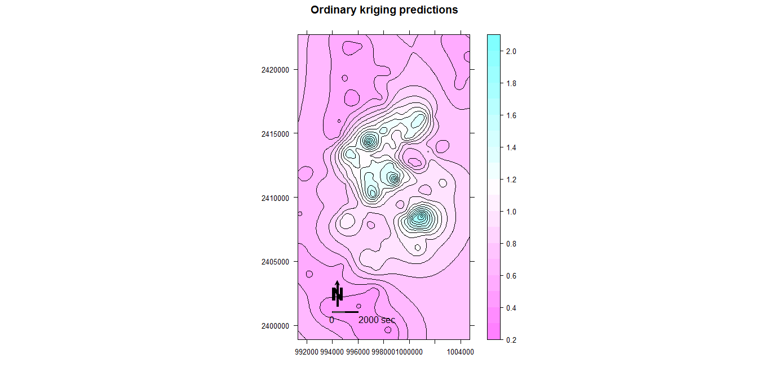
Spatial distribution of asthma SIR
18
The more affected areas are located at the centre of SMA
Notes:
Errata: the scale legend ‘seconds’ should be replaced by ‘metres’.

Slide 19
Results: age ⬄ asthma (Unstandardised rates)
19
Characteristics | Asthma attacks rate / percent-year
 | Neighbourhood deprivation index
 | A |  | B |  | C |  | D |  | E
 | Mean | SD | Mean | SD | Mean | SD | Mean | SD | Mean | SD
Age group | 0.08 | 0.09 | 0.21 | 0.13 | 0.32 | 0.22 | 0.38 | 0.31 | 0.37 | 0.20
0_9
10_19 | 0.06 | 0.07 | 0.14 | 0.13 | 0.21 | 0.19 | 0.22 | 0.15 | 0.20 | 0.14
20_39 | 0.07 | 0.07 | 0.11 | 0.08 | 0.13 | 0.07 | 0.11 | 0.06 | 0.22 | 0.11
40_64 | 0.06 | 0.05 | 0.13 | 0.11 | 0.23 | 0.16 | 0.25 | 0.24 | 0.42 | 0.35
>65 | 0.23 | 0.19 | 0.57 | 0.44 | 0.76 | 0.48 | 0.89 | 0.89 | 1.21 | 0.85
Overall | 0.09 | 0.06 | 0.20 | 0.11 | 0.27 | 0.10 | 0.27 | 0.17 | 0.37 | 0.16
It appears that the raw asthma attack rates increase with age, and is inversely related to the socio-economic status
Notes:
This justifies stratifying / standardising by age-groups to remove as much as possible confounding due to age.

Slide 20
Results: asthma ⬄ pollution X NDI ??
20
Characteristics | Asthma attacks rate / percent-year
 | Neighbourhood deprivation index
 | A |  | B |  | C |  | D |  | E
 | Mean | SD | Mean | SD | Mean | SD | Mean | SD | Mean | SD
PC1 quintiles | 0.06 | 0.03 | 0.16 | 0.12 | . | . | . | . | 0.39 | 0.02
0
1 | 0.12 | 0.03 | 0.20 | 0.10 | 0.24 | 0.05 | 0.30 | . | 0.41 | 0.18
2 | . | . | 0.26 | 0.07 | 0.30 | 0.13 | 0.36 | 0.02 | 0.36 | 0.13
3 | 0.15 | 0.06 | 0.12 | 0.05 | 0.25 | 0.09 | 0.33 | 0.27 | 0.39 | 0.23
4 | . | . | 0.28 | 0.10 | 0.26 | 0.10 | 0.21 | 0.09 | 0.25 | 0.08
Characteristics | Asthma attacks rate / percent-year
 | Neighbourhood deprivation index
 | A |  | B |  | C |  | D |  | E
 | Mean | SD | Mean | SD | Mean | SD | Mean | SD | Mean | SD
SO₂ quintiles | 0.06 | 0.04 | 0.14 | 0.10 | 0.26 | . | . | . | . | .
0
1 | 0.14 | 0.07 | 0.24 | 0.09 | 0.30 | 0.11 | 0.32 | 0.03 | 0.39 | 0.14
2 | 0.16 | . | 0.22 | 0.11 | 0.29 | 0.11 | 0.20 | 0.00 | 0.36 | 0.18
3 | 0.08 | . | 0.27 | 0.09 | 0.27 | 0.10 | 0.30 | 0.07 | 0.41 | 0.19
4 | . | . | 0.26 | 0.10 | 0.24 | 0.09 | 0.26 | 0.22 | 0.29 | 0.12
Notes:
Interaction effect?
See back-up slide #2 for unadjusted asthma = PC1 X NDI.
The raw asthma attack rates are UNADJUSTED for age-group.
There is dip in the effect for the most underpriviledged for the most polluted category?

Slide 21
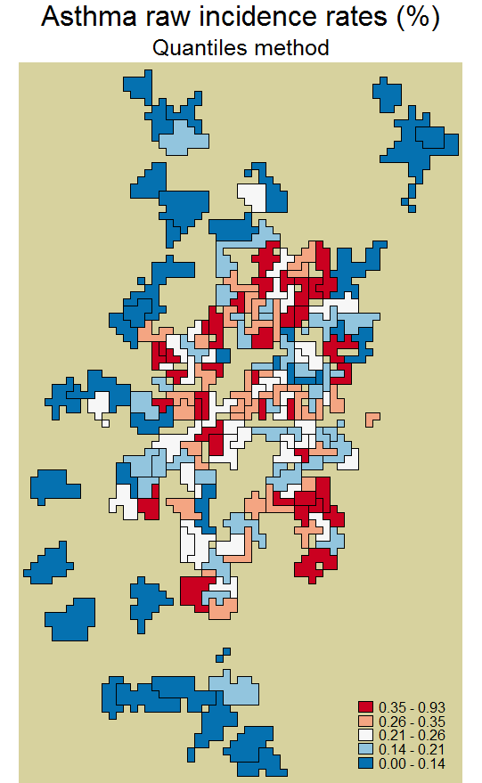
Disease mapping: Asthma incident rates (crude)

Slide 22
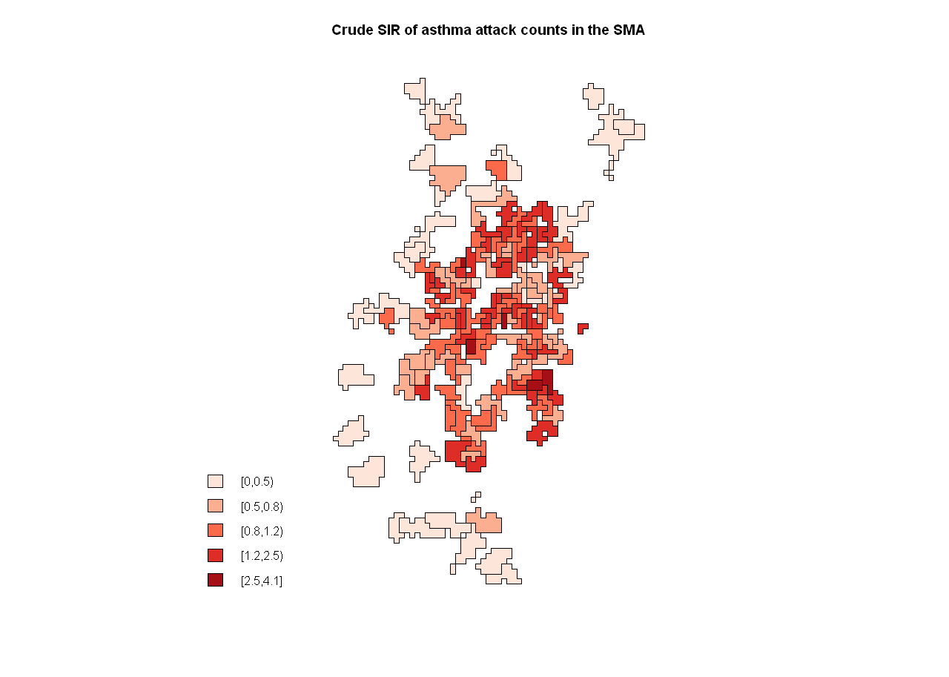
Asthma SIR (crude)
21
Notes:
Errata: ‘counts’ word is printed by mistake in the title. It should read “asthma attacks” simply.
SMR is standardised by age-groups.

Slide 23
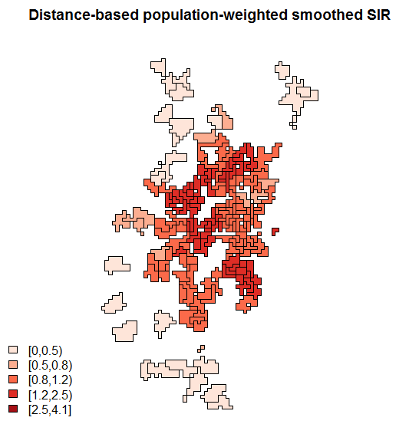
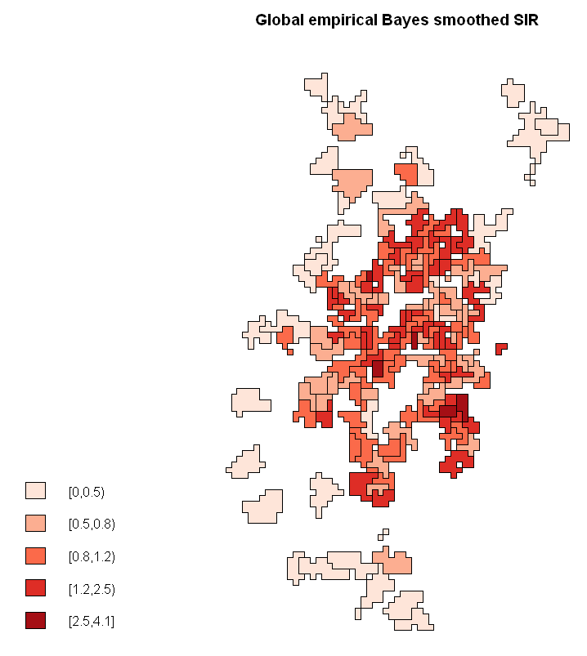

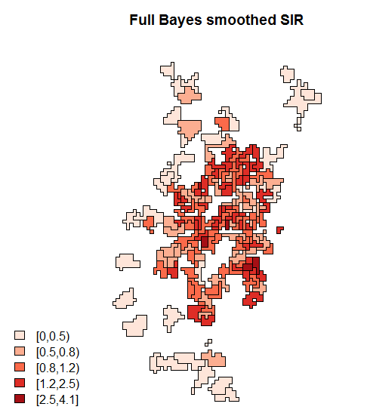
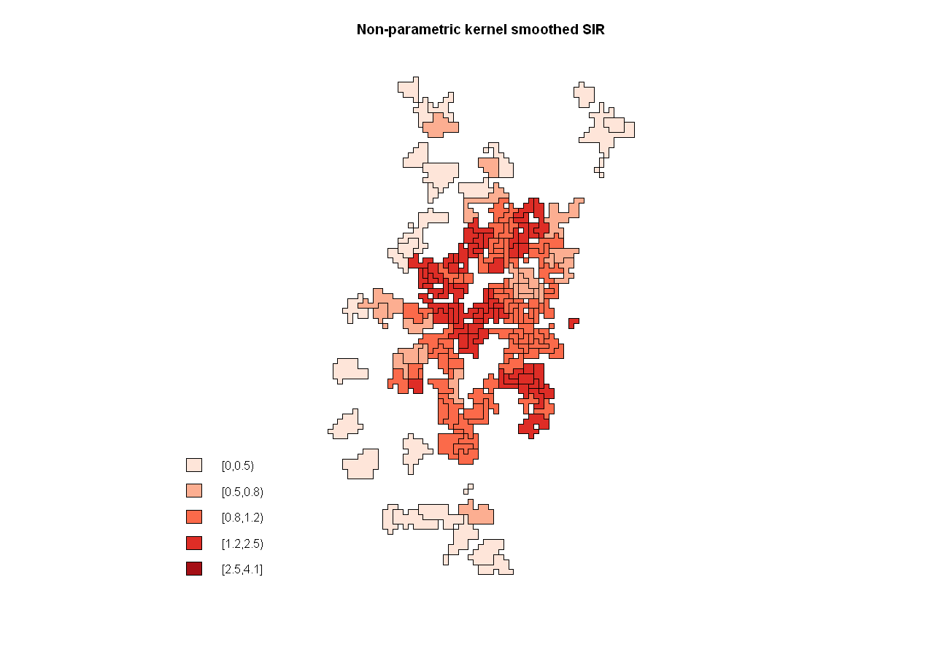
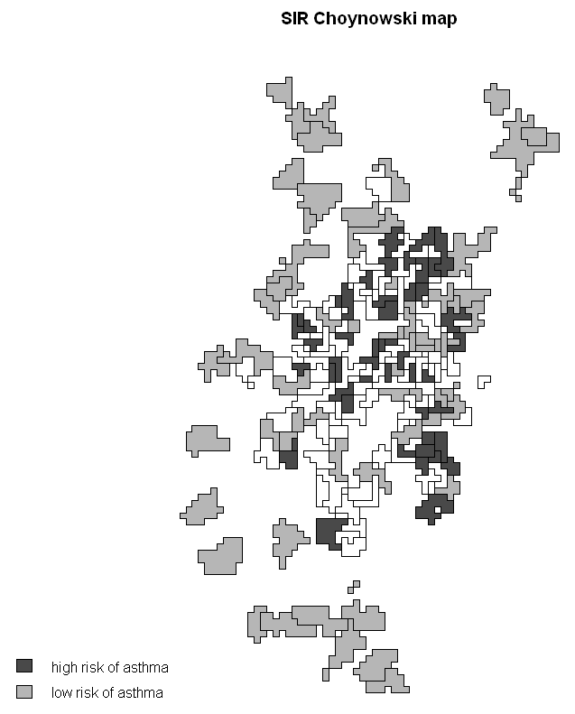
Spatial smoothing (asthma SIR)
22
Notes:
Distance-based and non-parametric are strong smoothing methods, where we used a moderate degree of smoothing in order not to lose too much finesse.
The distance taken was equal to 1500 metres.
The bandwidth taken was equal to 500.

Slide 24
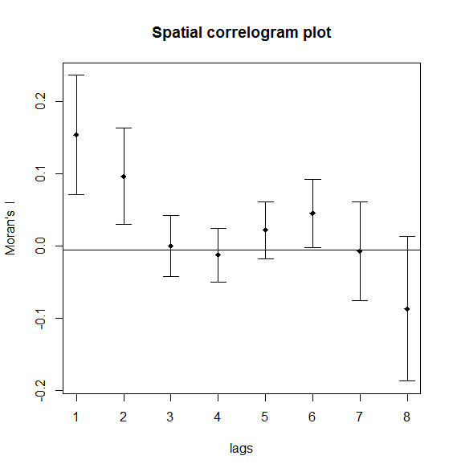
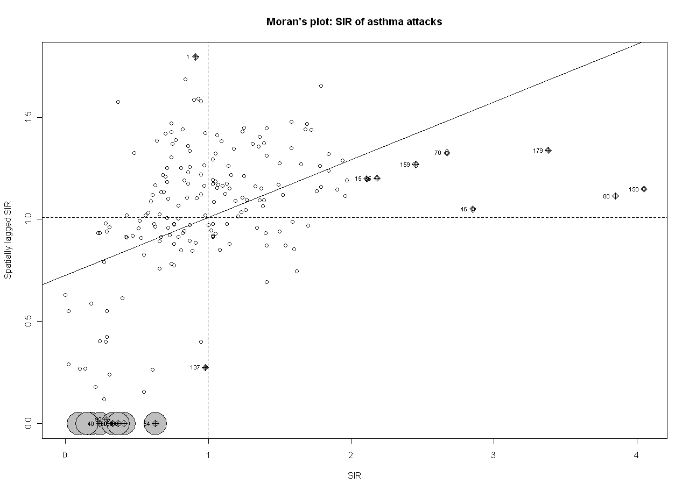
Are asthma SIRs spatially correlated?
23
Moran’s I was equal to 0.21 (p = 0.01)
Notes:
Moran’s I was based on the distance used (1500 metres).
A sine-hole effect could be perhaps observed due to circular nature of the variables (pollutants → NDI → asthma attacks).

Slide 25
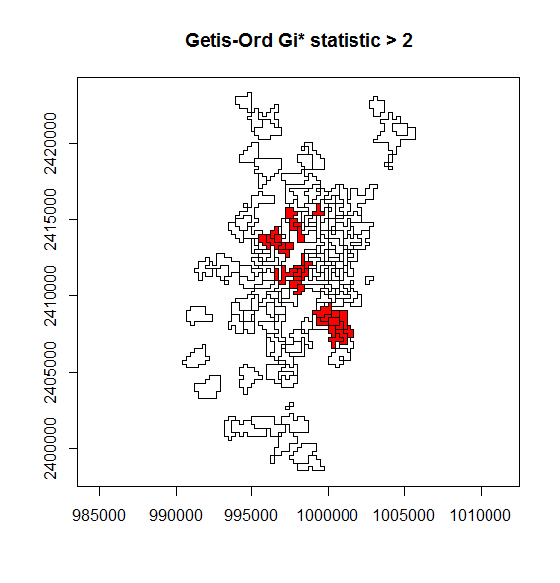
Is there any local clustering for the asthma SIR?
24
SaTScan analysis: Kulldorff’s scan statistic to detect all statistically significant disease clusters are shown in the next page
Notes:
2 ≈ 1.96.

Slide 26
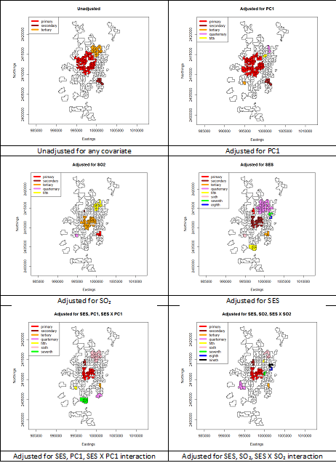
25
Primary clusters (‘hotspots’) are in red.

Slide 27
Kulldorff’s scan statistic (asthma SIR): loglikelihood ratios & risk ratios
26
Covariates | Loglikelihood ratio | Risk ratio
None | 202.65 | 1.53
PC1 | 164.00 | 1.46
SO₂ | 114.24 | 2.35
SES | 92.57 | 2.49
SES, PC1, SES X PC1 | 73.91 | 1.40
SES, SO₂, SES X SO₂ | 59.76 | 1.35
All p-values are highly significant
Notes:
Why the LRs decrease with increasing no. of covariates for adjustment ???

Slide 28
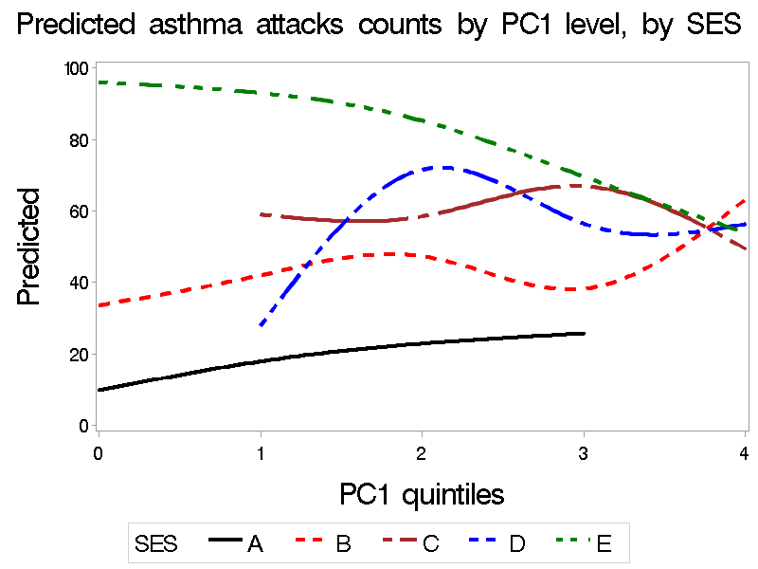
Naive analysis ⬄ zones are i.i.d.
27
Parameter | SES | RR | 95% LCL | 95% UCL
Intercept |  | 0.24 | 0.18 | 0.34
SES | B | 2.58 | 1.79 | 3.73
SES | C | 4.15 | 2.51 | 6.88
SES | D | 8.25 | 3.15 | 21.63
SES | E | 7.42 | 4.70 | 11.71
PC1 |  | 1.36 | 1.11 | 1.66
PC1*SES | B | 0.84 | 0.67 | 1.05
PC1*SES | C | 0.74 | 0.59 | 0.95
PC1*SES | D | 0.62 | 0.44 | 0.86
PC1*SES | E | 0.68 | 0.53 | 0.88
Dispersion |  | 0.21*
The model is fitted assuming a negative-binomial distribution of the outcome (fit = ‘good’, but ...)
‘PC1’ variable (= traffic-related air pollution) is continuous
SES (= neighbourhood deprivation) is categorical
‘PC1’ is found to be statistically significant independent of SES
Only ‘PC1’ results are presented here
Notes:
* Dispersion parameter is not exponentiated.
SO₂ results are not shown (very similar).
Category ‘A’ is considered as the reference category.

Slide 29
CAR model (PC1): estimated RRs for asthma attacks
28
Parameter | Model 1 (± 95% Credible Interval) | Model 2 (± 95% Credible Interval) | Model 3a (± 95% Credible Interval) | Model 3b (± 95% Credible Interval) | Model 4a (± 95% Credible Interval) | Model 4b (± 95% Credible Interval)
Mean | 0.91 (0.88-0.94) | 0.85 (0.78-0.92) | 0.61 (0.52-0.70) | 0.63 (0.57-0.70) | 0.56 (0.48-0.67) | 0.52 (0.43-0.61)
PC1 |  | 1.07 (0.99-1.16) | 1.03 (0.96-1.10) | 1.02 (0.96-1.09) | 1.16 (0.95-1.40) | 1.31 (1.11-1.56)
SES category E |  |  | 3.40 (2.49-4.77) |  | 4.98 (3.06-8.02)
SES category D |  |  | 2.22 (1.55-3.24) |  | 5.22 (2.20-13.01)
SES category C |  |  | 2.31 (1.70-3.20) |  | 2.78 (1.69-4.70)
SES category B |  |  | 1.81 (1.37-2.44) |  | 1.92 (1.34-2.79)
SES deprivation (continuous) |  |  |  | 1.26 (1.18-1.34) |  | 1.47 (1.31-1.66)
PC1 X SES category E |  |  |  |  | 0.78 (0.62-0.99)
PC1 X SES category D |  |  |  |  | 0.71 (0.52-0.96)
PC1 X SES category C |  |  |  |  | 0.87 (0.70-1.10)
PC1 X SES category B |  |  |  |  | 0.94 (0.76-1.16)
PC1 X SES deprivation (continuous) |  |  |  |  |  | 0.92 (0.87-0.96)
σ²_{u} | 0.12 (0.01-0.32) | 0.13 (0.01-0.35) | 0.03 (0.00-0.17) | 0.02 (0.00-0.13) | 0.03 (0.00-0.20) | 0.02 (0.00-0.14)
σ²_{v} | 0.21 (0.14-0.31) | 0.21 (0.13-0.30) | 0.18 (0.12-0.24) | 0.19 (0.14-0.25) | 0.17 (0.11-0.23) | 0.18 (0.12-0.24)
DIC | 1439.61 | 1439.03 | 1436.46 | 1436.77 | 1436.74 | 1435.77
Notes:
Deprivation category ‘A’ is considered as the reference category.
Also, CAR median models were fitted; assumes a double exponential (Laplace) distribution.
Model 1: no fixed covariates (null model)
Model 2: model 1 + exposure (PC1)
Model 3a: model 2 + socio-economic status (categorical variable)
Model 3b: model 2 + socio-economic status (continuous variable)
Model 4a: model 3a + interaction term (exposure X socio-economic status (categorical variable))
Model 4b: model 3b + interaction term (exposure X socio-economic status (continuous variable))
CAR: Conditional Auto-Regressive
DIC: Deviance Information Criterion
PC1: Principal Component1 extracted from four traffic-related air pollutants (i.e., NO₂, PM₁₀, CO, Benezene)
Mean: exponentiated ‘alpha’ parameter; it denotes the relative ‘baseline’ risk (i.e., those residing in PC1 ‘zone’)
σ²_{u}: variance of the spatial or structured heterogeneity
σ²_{v}: variance of the unstructured heterogeneity

Slide 30
Discussion (1)
29
In the null model (without covariates), the spatial heterogeneity (σ²_{u}) accounted for 36% of the total heterogeneity
In the interaction model, spatial heterogeneity was reduced substantially (to 10% of the total), but the unstructured heterogeneity (σ²_{v}) had little impact
This highlights the fact that neighbourhood deprivation was able to ‘absorb’ a large part (83%) of the spatial heterogeneity compared to only 14% ‘absorbed’ by unstructured heterogeneity, which could arise from:
Exposure misclassification
Geocoding the place of intervention than actual residence
Subjects changing their place of residence during the long study period
Unmeasured covariates
Outcomes are asthma calls, which need clinical confirmation
The effect of exposure in the interaction models is ‘reinforced’ compared to the ‘exposure-only’ models

Slide 31
Discussion (2)
30
The interaction model signifies:
At low levels of air pollution, the most privileged are the least affected, but with increasing air pollution levels, they are the most impacted in terms of difference (Δ) from ‘baseline’*
Whereas the most deprived have already a high ‘baseline’ rate of asthma attacks, this does not increase further with greater pollution (but why?)
Caveats:
Zone of intervention is recorded by the emergency services, which may be different from that of the actual residence of the subject
Gender information missing
Ecological fallacy
Strengths:
Spatial correlations are included in the inference
We also tested our results using robust CAR median models → consistent results
* Means ‘no pollution’
Notes:
By why the SIR decreases in the most deprived with increasing pollution?
OUR RESULTS INDICATE A ‘THIRD’ HYPOTHESIS OF A ‘SATURATION-EFFECT’ OF AIR POLLUTION???

Slide 32

Let’s plug-in our estimates and fit the puzzle
31
I ≈ 0.70
I = 0.21
NO₂
RR = 1.31
CO
Air pollution
Asthma attack ‘calls’
PM
Benzene
RR = 0.92*
Unknown agent
p < 0.01
RR = 1.47
Deprivation
Latent factors mediated
I ≈ 0.30*
* In the “simplified” case, where NDI is continuous.
The interaction model explained 40% of total variability (mainly spatial), but still 60% variability (mainly unstructured) was not explained
Notes:
A0 risk = exp((log(0.52)) + (log(1.31))*(0) + (log(1.47)*(1)) + (log(0.92))*(0)*(1)) = 0.76.
A4 risk = exp((log(0.52)) + (log(1.31))*(4) + (log(1.47)*(1)) + (log(0.92))*(4)*(1)) = 1.61,
(so, delta = 1.61 - 0.76 = 0.85, or risk increase by a factor of 2.12 for NDI ‘A’).
E0 risk = exp((log(0.52)) + (log(1.31))*(0) + (log(1.47)*(5)) + (log(0.92))*(0)*(5)) = 3.57.
E4 risk = exp((log(0.52)) + (log(1.31))*(4) + (log(1.47)*(5)) + (log(0.92))*(4)*(5)) = 1.98.

Slide 33
Perspectives & thoughts (1)
32
The results were stable and consistent w.r.t. exposure over time (zone), and w.r.t. exposure-outcome association
Attenuation of mean estimates was observed in the CAR model compared to the naïve analysis on accounting for spatial correlation
Outcome = {asthma x severity (attacks)} x “emergency call”
“Emergency call” = access to resources x awareness x ...
Medical validation of the “asthma attacks calls” could therefore be carried out as a SENSITIVITY analysis to support our results:
Typically, it will have less statistical power
But, less heterogeneity
And, the trade-off between power & heterogeneity

Slide 34
Perspectives & thoughts (2)
33
Latent interaction – if the interaction effect was not significant, we might have been “happy” with the first hypothesis and “conclude” that NDI acts as a confounder → pollution does not have a significant impact on the outcome, BUT as the interaction effect was significant, this “brought back” the differential health effect of pollution on the outcome
Models which cited the first hypothesis to be true in the literature (i.e., “differential exposure” hypothesis), perhaps did not have enough power to tease out the latent interaction that might have been playing a role
New synthetic zones and new NDI were created for the study. Previous study by Laurent et al. using IRIS classification and a different SES indicator did not find statistically significant association. However, the statistical power was also less in that study comprising of 5-year data instead of 8-year data as in this study

Slide 35
Thank you !
34
Email: banerjee@u707.jussieu.fr
EPAR Department (Dr. Isabella Annesi-Maesano),
INSERM UMR-S 707 – Hôpital Saint-Antoine, UPMC Paris 6,
Bureau 804,
27 rue Chaligny, 75571 Paris Cedex 12;
Tel: +33 1 4473 8657;
Fax: +33 1 4473 8454

Slide 36
Back-up slides
35

Slide 37
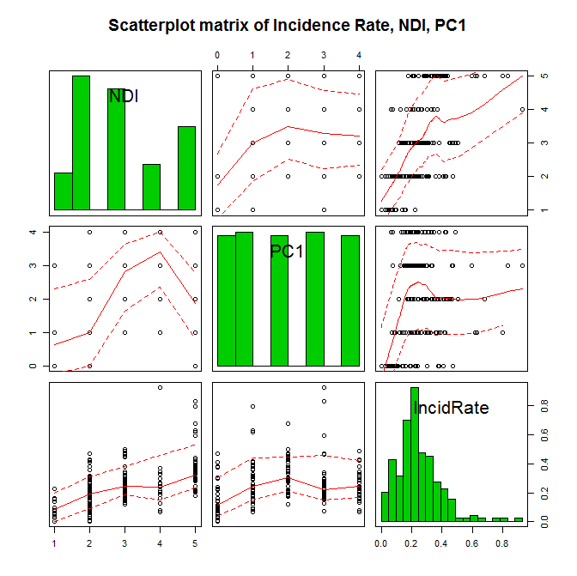
36
Notes:
The asthma attack rates (raw incident rates) were UNADJUSTED for age-group.

Slide 38
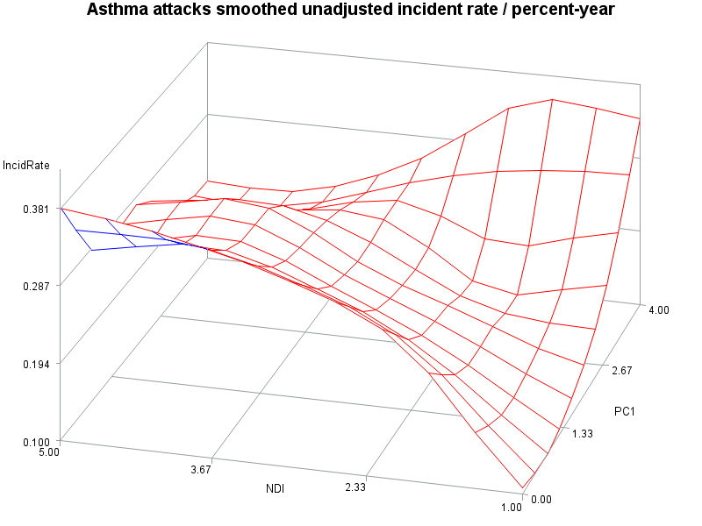
37
Notes:
The SMOOTHED asthma attack rates (raw incident rates) were UNADJUSTED for age-group.

Slide 39
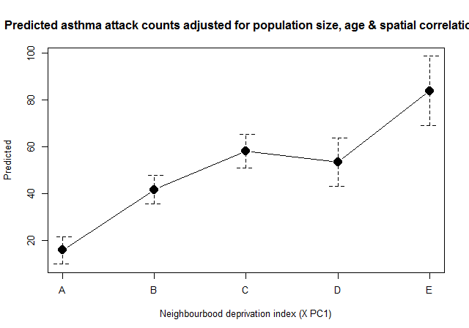
38
Marginally the interaction model
Notes:
The graph shows non-overlapping 95% CIs.
It is the marginal representation of the full interaction (NDI X PC1) model.
Similar results were obtained for SO₂.

Slide 40
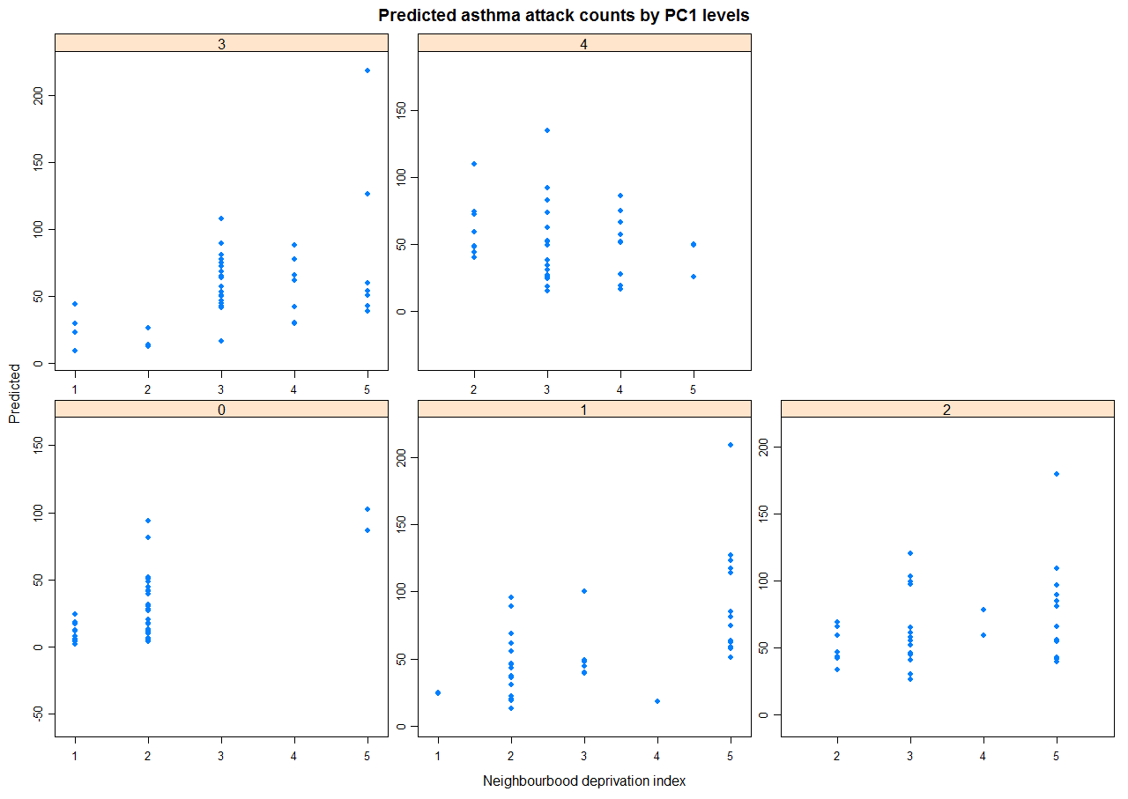
39
Notes:
Note: neighbourhood deprivation index is plotted as integers from 1 through 5 (in the x-axes).
Predicted asthma attack counts adjusted for population size, age & spatial correlations.
The blue dots are the zones.
Similar results were obtained for SO₂.

Slide 41
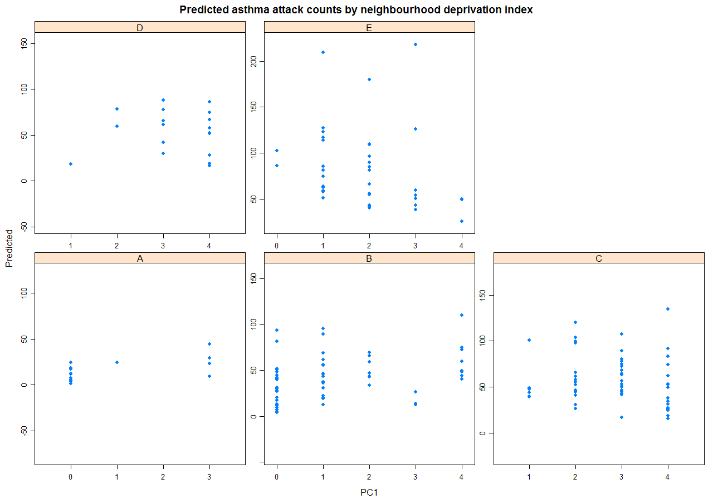
40
Notes:
Predicted asthma attack counts adjusted for population size, age & spatial correlations.
The blue dots are the zones.
Similar results were obtained for SO₂.

Slide 42
CAR model (SO₂): estimated RRs for asthma attacks
41
Parameter | Model 1 (± 95% Credible Interval) | Model 2 (± 95% Credible Interval) | Model 3a (± 95% Credible Interval) | Model 3b (± 95% Credible Interval) | Model 4a (± 95% Credible Interval) | Model 4b (± 95% Credible Interval)
Mean | 0.91 (0.88-0.94) | 0.78 (0.70-0.87) | 0.60 (0.52-0.69) | 0.63 (0.56-0.70) | 0.58 (0.49-0.68) | 0.51 (0.43-0.60)
SO₂ |  | 1.16 (1.06-1.29) | 1.04 (0.96-1.14) | 1.04 (0.97-1.13) | 1.10 (0.83-1.49) | 1.34 (1.15-1.60)
SES category E |  |  | 3.29 (2.36-4.59) |  | 4.22 (2.54-6.96)
SES category D |  |  | 2.13 (1.44-3.10) |  | 2.86 (1.41-6.08)
SES category C |  |  | 2.25 (1.62-3.12) |  | 2.91 (1.82-4.59)
SES category B |  |  | 1.78 (1.32-2.39) |  | 1.65 (1.17-2.35)
SES deprivation (continuous) |  |  |  | 1.25 (1.17-1.33) |  | 1.45 (1.30-1.63)
SO₂ X SES category E |  |  |  |  | 0.87 (0.64-1.20)
SO₂ X SES category D |  |  |  |  | 0.89 (0.62-1.26)
SO₂ X SES category C |  |  |  |  | 0.89 (0.66-1.23)
SO₂ X SES category B |  |  |  |  | 1.06 (0.78-1.41)
SO₂ X SES deprivation (continuous) |  |  |  |  |  | 0.92 (0.87-0.97)
σ²_{u} | 0.12 (0.01-0.32) | 0.18 (0.05-0.44) | 0.04 (0.00-0.20) | 0.03 (0.00-0.16) | 0.04 (0.00-0.22) | 0.04 (0.00-0.20)
σ²_{v} | 0.21 (0.14-0.31) | 0.18 (0.10-0.26) | 0.17 (0.11-0.23) | 0.19 (0.13-0.25) | 0.17 (0.11-0.24) | 0.17 (0.11-0.23)
DIC | 1439.61 | 1436.90 | 1435.68 | 1435.79 | 1435.19 | 1435.97
Notes:
Deprivation category ‘A’ is considered as the reference category.
Also, CAR median models were fitted assuming a double exponential (Laplace) distribution.
Model 1: no fixed covariates (null model)
Model 2: model 1 + exposure (SO₂)
Model 3a: model 2 + socio-economic status (categorical variable)
Model 3b: model 2 + socio-economic status (continuous variable)
Model 4a: model 3a + interaction term (exposure X socio-economic status (categorical variable))
Model 4b: model 3b + interaction term (exposure X socio-economic status (continuous variable))
CAR: Conditional Auto-Regressive
DIC: Deviance Information Criterion
PC1: Principal Component1 extracted from four traffic-related air pollutants (i.e., NO₂, PM₁₀, CO, Benezene)
Mean: exponentiated ‘alpha’ parameter; it denotes the relative ‘baseline’ risk (i.e., those residing in PC1 ‘zone’)
σ²_{u}: variance of the spatial or structured heterogeneity
σ²_{v}: variance of the unstructured heterogeneity

Slide 43
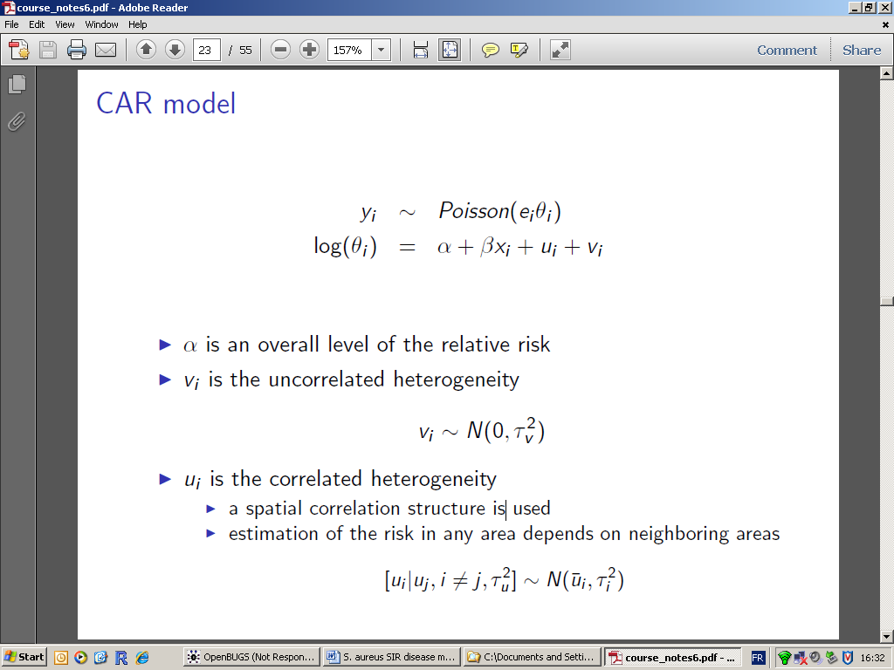
CAR Normal model
42
The so-called Conditional Auto-Regressive model assumes that the observed counts in the zone i (standardised for the age-group g) follow a Poisson distribution with parameter e_{i}θ_{i}
The zone-specific log-risk ratios: log-θ_{i} are modelled by the following equation:
with, y_{i} = observed counts in the zone i follow a Poisson distribution with mean as e_{i}θ_{i}, α = the overall log risk ratio, v_{i} = the spatially uncorrelated heterogeneity (i.e., unexplained random variance), and u_{i} is the spatially correlated random heterogeneity (i.e., a spatial correlation structure, which reflects the spatial dependency given by the spatial dependency weight W-matrix); the random-effects are assumed to follow a CAR Normal distribution, which depends on its neighbouring zones and is expressed by the following equation:
Notes:
The predicted means of CAR model are the sum of µ_{i} and weighted sum of responses of the neighbours.
Here, the weights = 1 if contiguous neighbour, = 0 otherwise.

